Slide 1


CSS Preprocessors: Revolutionizing Styling
Let's explore CSS preprocessors, specifically SASS, to streamline your styling workflows and boost productivity.
by Mohammed Rayan Hussain

Slide 2
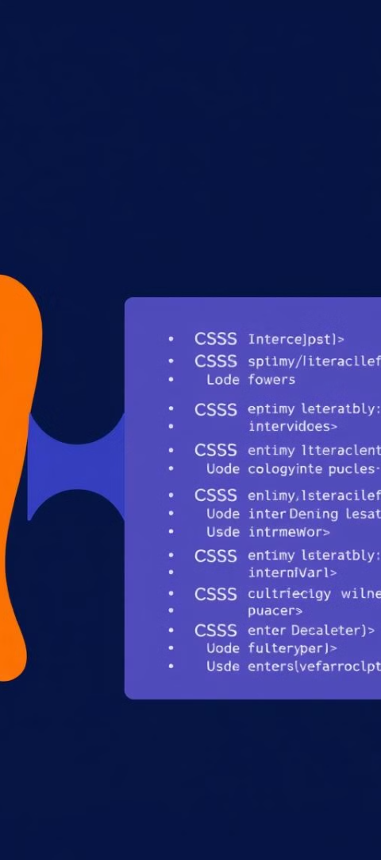
What are CSS Preprocessors?
Extend CSS
Improved Code
A tool that extends CSS functionality by allowing
Converts preprocessor code into standard CSS.
Variables
A CSS preprocessor like SASS allows developers to write more advanced and structured code with features like variables, nesting, and mixins.
Nesting
Mixins
Functions and more.
This preprocessed code cannot be directly understood by browsers, as browsers only understand standard CSS.

Slide 3

Introducing SASS
1
SASS (Syntactically Awesome Stylesheets)
2
SCSS
Similar syntax to CSS, easy to learn.
Popular and powerful CSS preprocessor.
3
Indented SASS
Minimalist syntax without braces or semicolons.

Slide 4
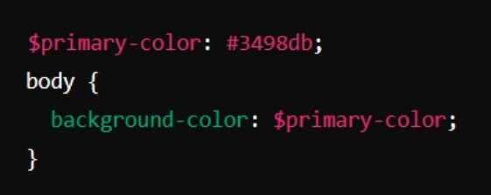
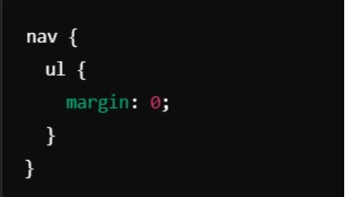
SASS: Key Features
1
Variables
2
Nesting
Store reusable values like colors and fonts.
Clean structure by nesting selectors within each other.
3
Partials and Imports
Split CSS into manageable files for organization.

Slide 5
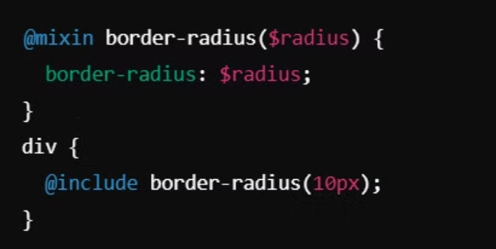
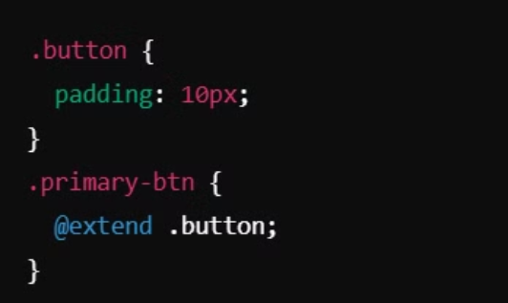
More SASS Features
1
Mixins
2
Inheritance
Define reusable blocks of code.
Share styles across selectors using @extend.

Slide 6

The Benefits of SASS
1
DRY Principle
Don't Repeat Yourself: Write less, maintain easily.
2
Improved Readability
Code is cleaner, more organized, and easier to understand.
3
CSS Compatibility
Regular CSS can be used within SASS files.
4
Built-in Functions
Calculations, color manipulation, and more.

Slide 7



How SASS Works
Write SASS
Compile
Use CSS
Write code in .scss or .sass file
Compile it into a .css file using tools like:
Use the generated CSS file in your project.
Command-line (sass input.scss output.css)
Build tools (Webpack, Gulp).

Slide 8
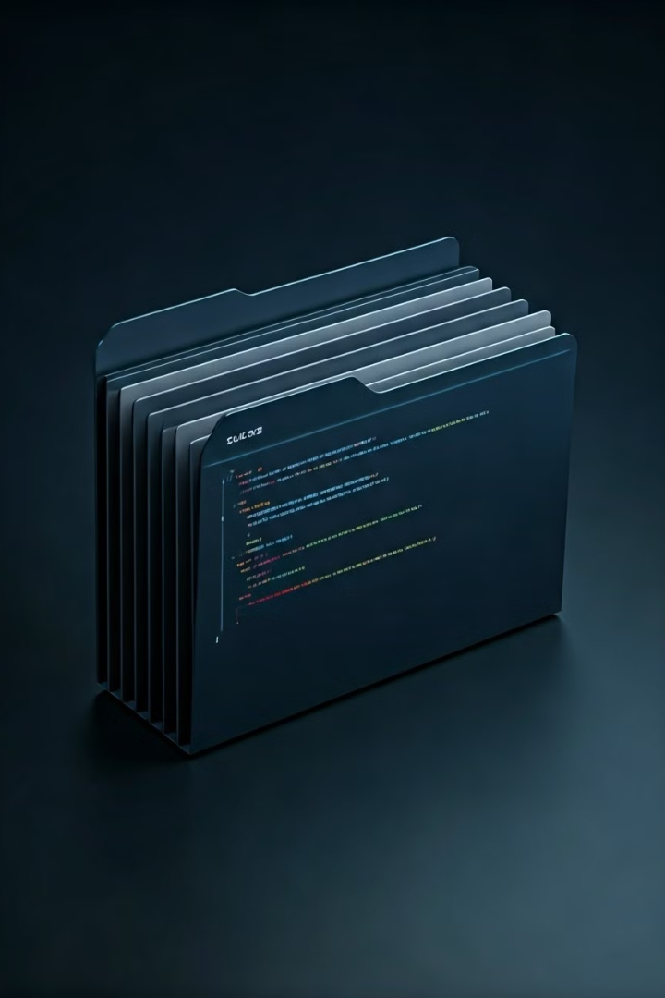
Real-World Uses
1
Responsive Design
Simplify breakpoints and ensure a seamless user experience
2
Large Projects
Modular code for complex stylesheets.
3
Dynamic Styling
Themes, variables, and functions for flexibility.

Slide 9
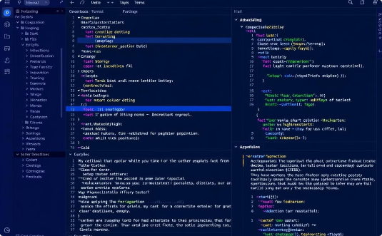
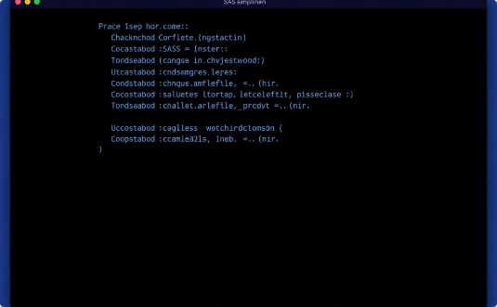

Popular Tools for SASS
Text Editors
Compilers
Frameworks
Popular editors like VS Code and Sublime Text offer powerful SASS support with syntax highlighting and auto-completion.
Essential compilation tools like Node-sass and Dart-sass transform SASS code into browser-ready CSS.
Major frameworks like Bootstrap and Foundation leverage SASS for powerful styling capabilities.

Slide 10

Conclusion
1
Powerful Development Tool
SASS is a powerful tool that revolutionizes how we handle CSS styling, making development more efficient and maintainable.
2
Bridging Technologies
Effectively bridges the gap between traditional CSS limitations and modern development needs.
3
Enhanced Productivity
Mastering SASS leads to significantly improved productivity and cleaner, more organized code structures.

